Slide 1
Lab 2 - SVM

Slide 2
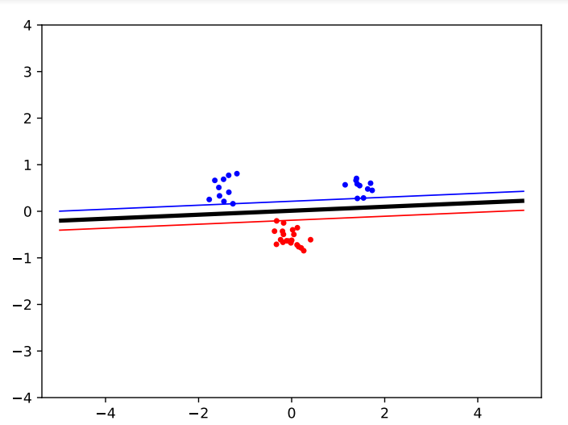
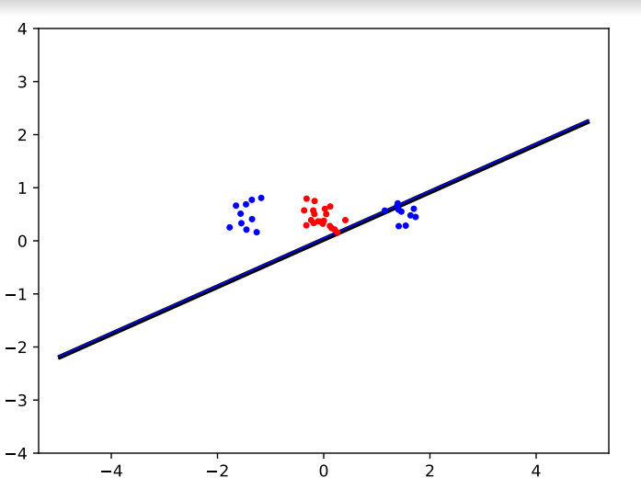
1 )Move the clusters around and change their sizes to make it easier or harder for the classifier to find a decent boundary. Pay attention to when the optimizer (minimize function) is not able to find a solution at all
Decision Boundary for easy cluster using Kernel –Linear
After moving the cluster around and making the dataset complex

Slide 3
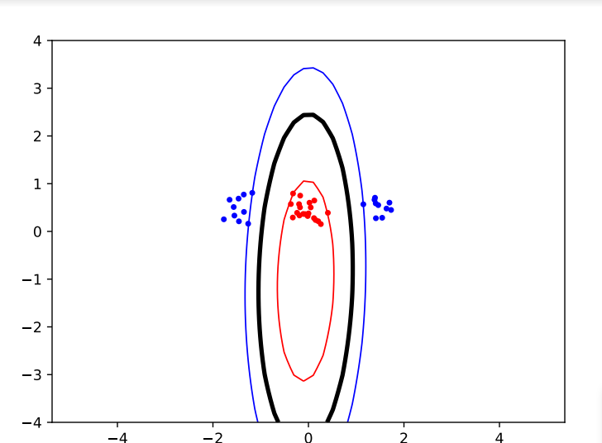
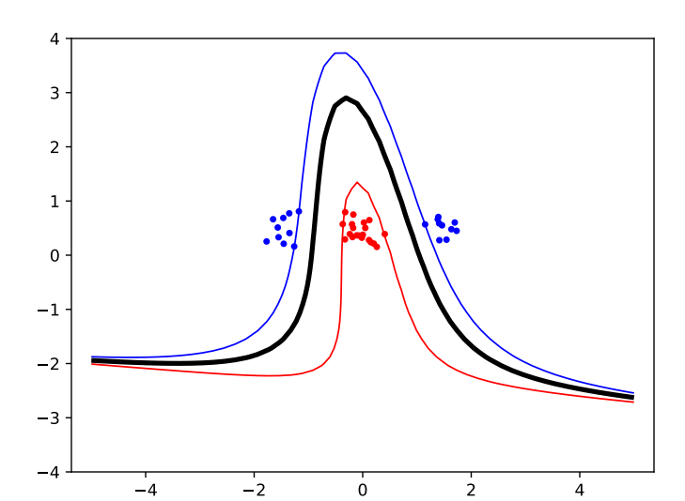
2) Implement the two non-linear kernels. You should be able to classify very hard data sets with these
Classification of hard data using polynomial kernel with degree 2
Classification of data using polynomial kernel degree 3

Slide 4
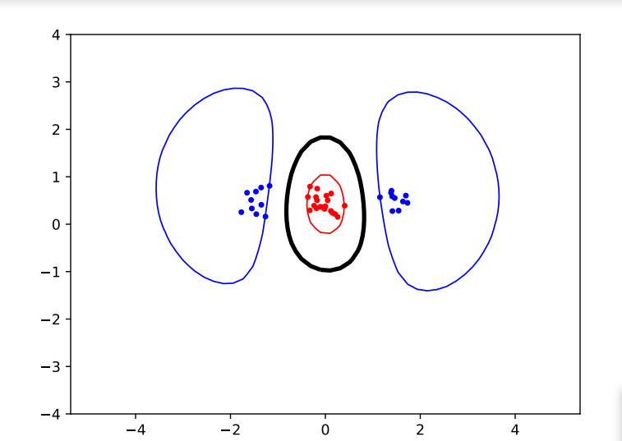
Classification of data using RBF kernel sigma 1
Classification of data using RBF kernel sigma 10

Slide 5
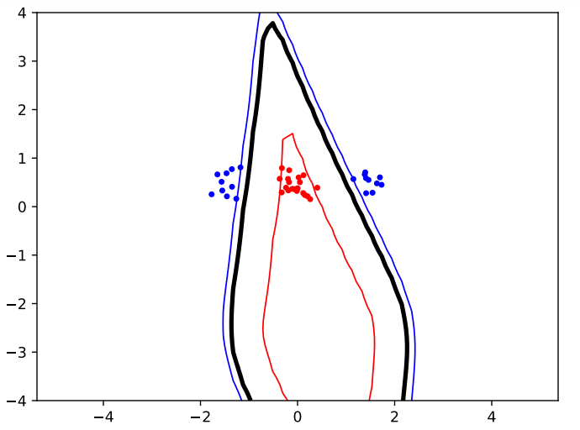
3)The non-linear kernels have parameters; explore how they influence the decision boundary. Reason about this in terms of the bias-variance trade-off
Classification of data using polynomial kernel degree 3
Classification of data using polynomial kernel degree 8

Slide 6
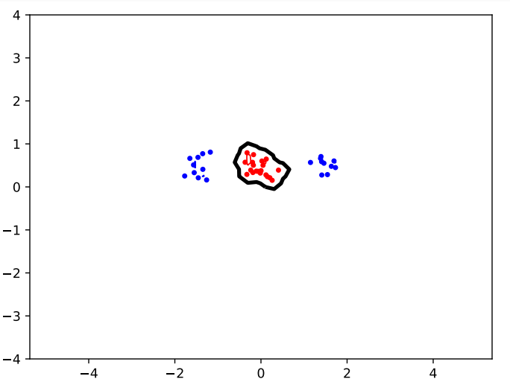
Classification of data using RBF kernel sigma 0.1

Slide 7
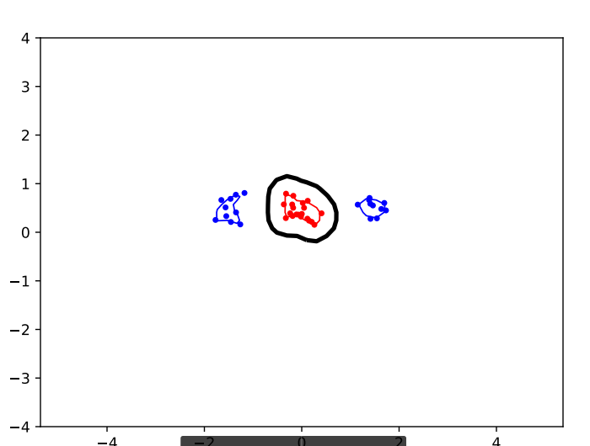
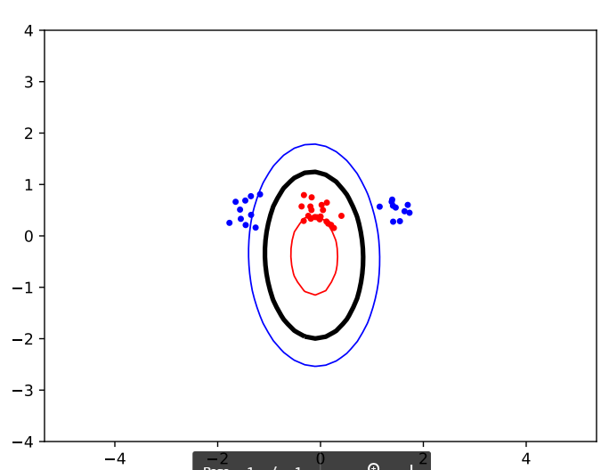
Classification of data using RBF kernel sigma 0.2
Classification of data using RBF kernel sigma 10

Slide 8
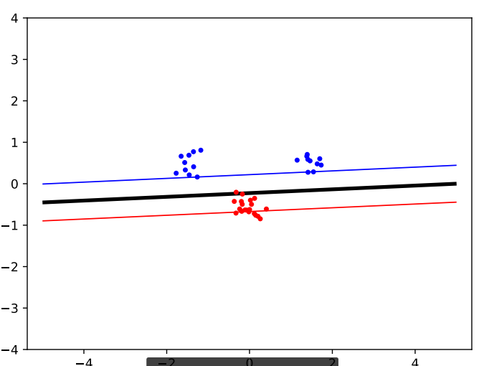
4. Explore the role of the slack parameter C. What happens for very large/small values?
Using c =0.5

Slide 9
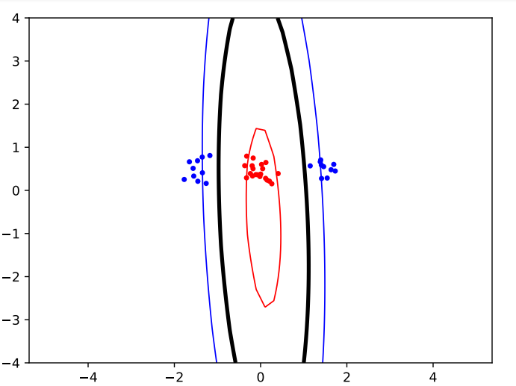
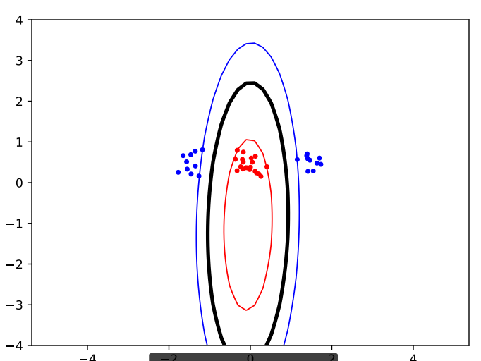
Polynomial Kernel
C=0.2
C=2

Slide 10
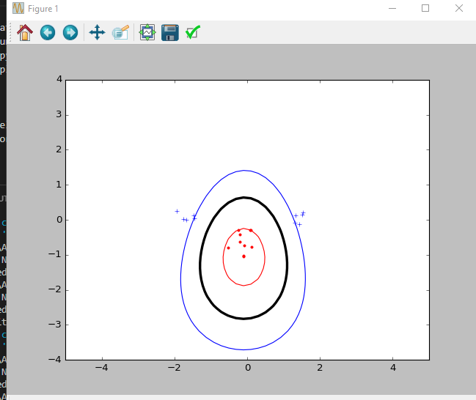
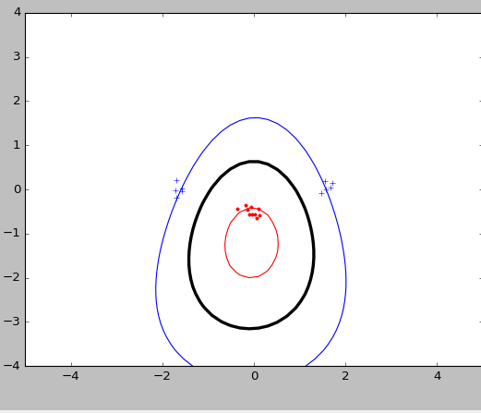
RBF Kernal
C=10
C=3

